Slide 1
https://rstudio.cloud/

Slide 2
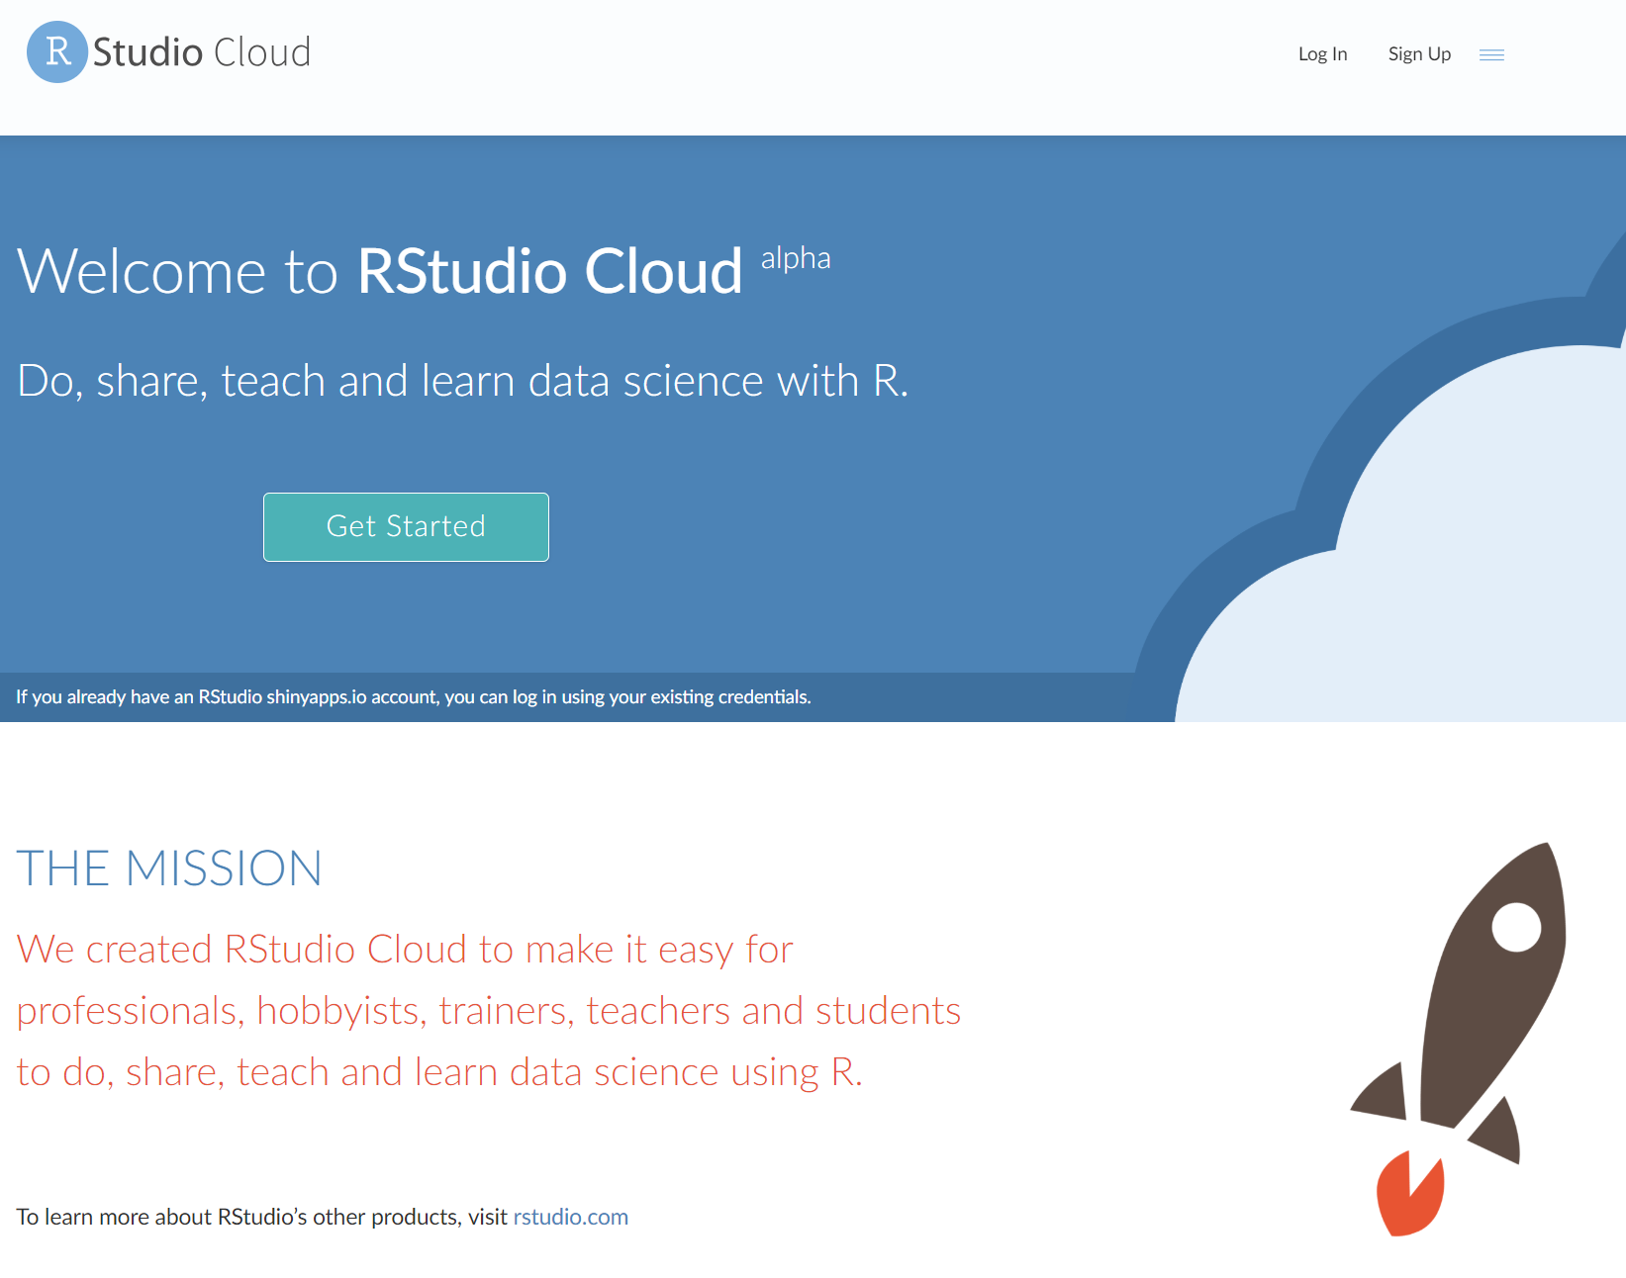
Sign up for an account

Slide 3
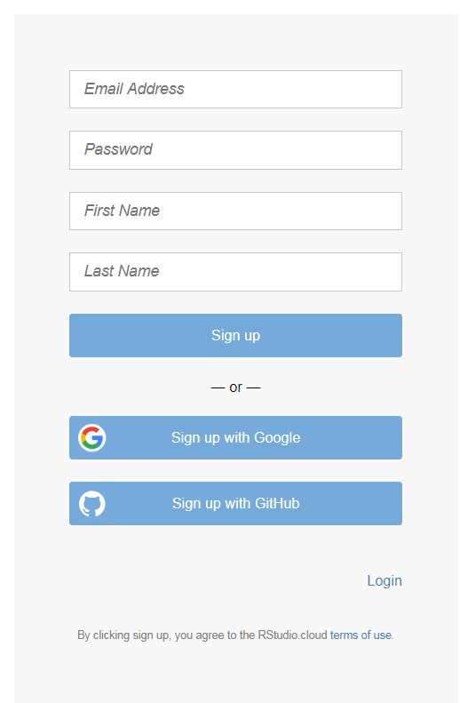
Sign up using whichever method is most convenient.
Make note of login name/password for future use

Slide 4
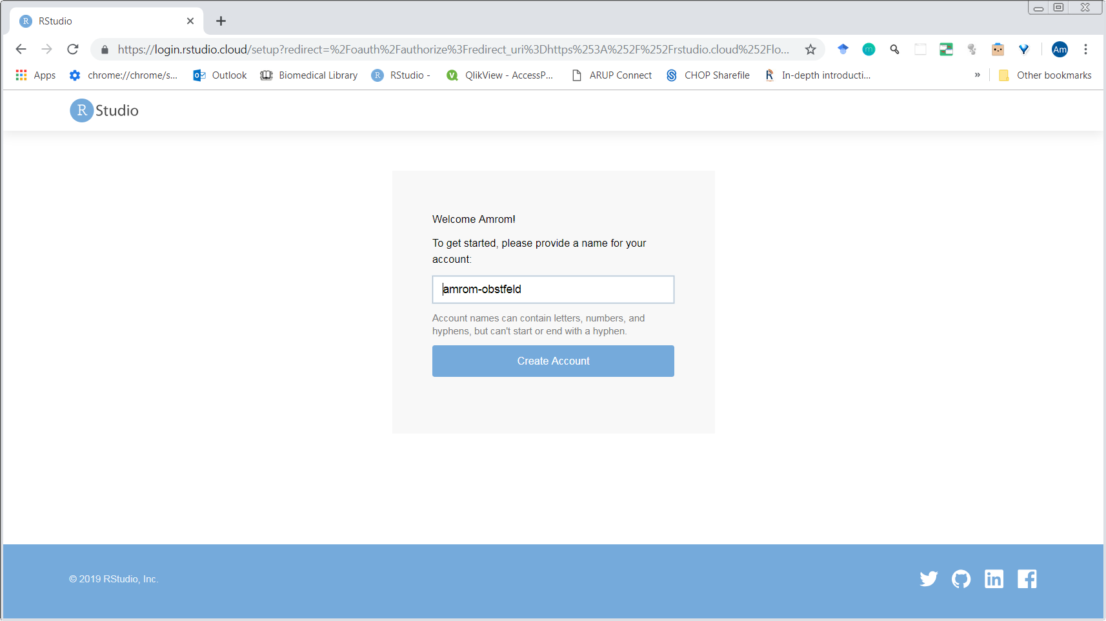
Confirm to create account

Slide 5
